Slide 1
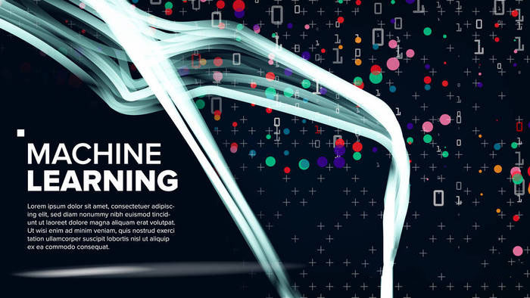
Neural Style Transfer
Group:
Presentation day:
Neural Networks

Slide 2

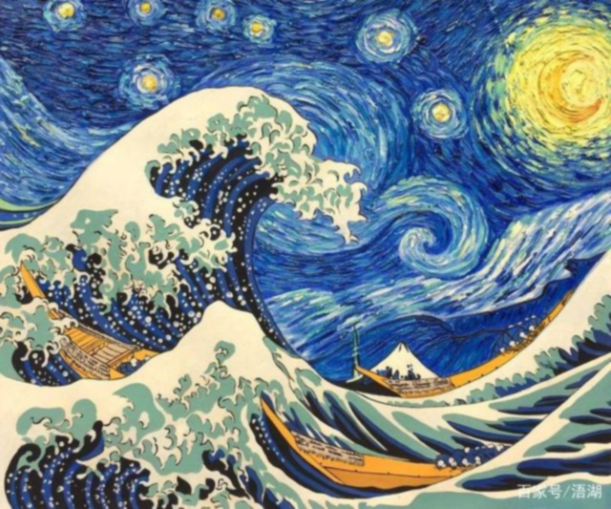
Introduction
The Background of Neural Style Transfer
Problem analysis
Three factors limitations - cause - effect
CONTENTS
Methods
The proposed optimization scheme
Achievement
Optimization results Display
Conclusion
Vision of Neural Style Transfer

Slide 3
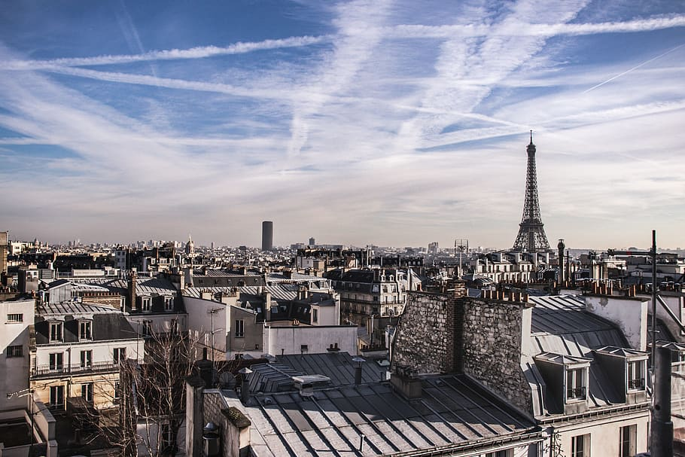
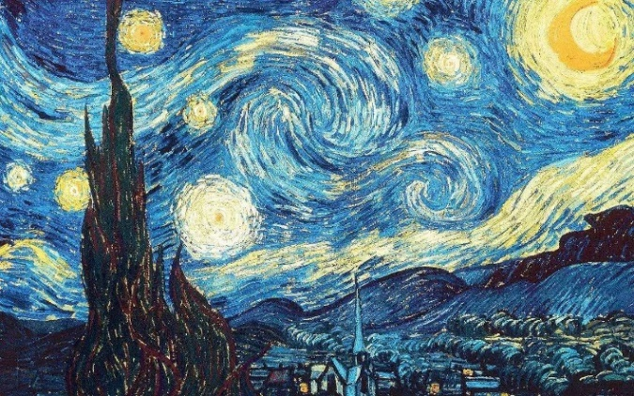
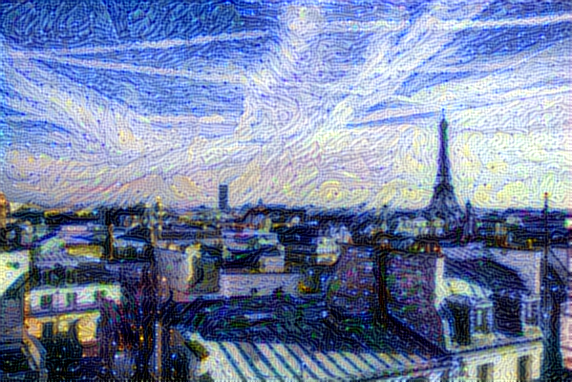
Neural Style Transfer
Introduction
Content Image
picture source: this image is 【———】
picture source: this image is 【———】
picture source: this image is 【———】
Style Image
picture source: this image is 【———】
picture source: this image is 【———】
picture source: this image is 【———】
Generated Image
picture source: this image is 【———】
picture source: this image is 【———】
picture source: this image is 【———】

Slide 4

Introduction
Neural Style Transfer
Neural Style Transfer (NST) definition: the process of using Convolutional Neural Network (CNN) to render a content image in different styles. ---- Gatys et al.(2016)
Content Image
Style Image
Generated Image
picture source: this image is 【———】
picture source: this image is 【———】
picture source: this image is 【———】
Quantify the content of the content image 【待完善】
Visual Texture Modeling：Style image extracts the style features
Image Reconstruction：Get high-level semantic information in the content image

Slide 5
Introduction
Neural Style Transfer
Randomly initialize the noise image
Input VGG19 loss function
Calculate the gradient of the loss function
Adjust each pixel value
Generated image
Iterative x N
noise Image【待替换】
Generated Image

Slide 6

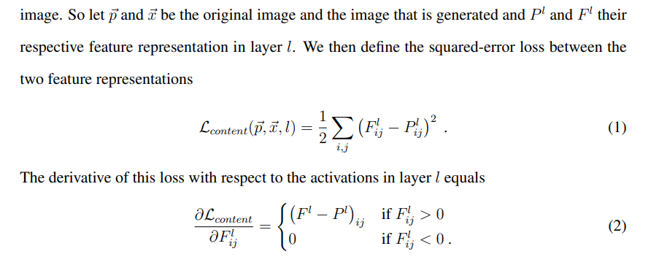





Introduction
Neural Style Transfer
$J_{content}$ -- content loss function
$α×J_{content}(C, G)$
Content Image
$β×J_{style}(S, G)$
Generated Image
$J_{(G)}$ -- total loss function
$J_{style}$ -- style loss function
Style Image

Slide 7
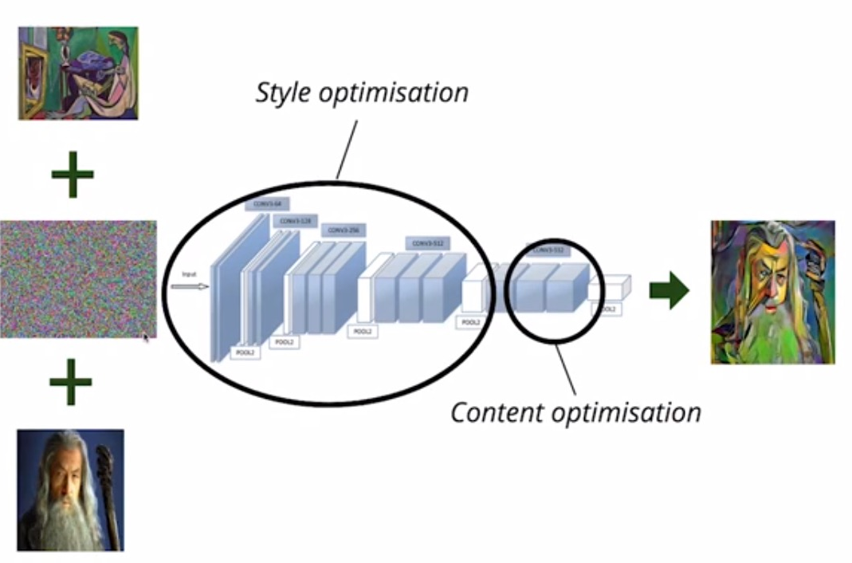
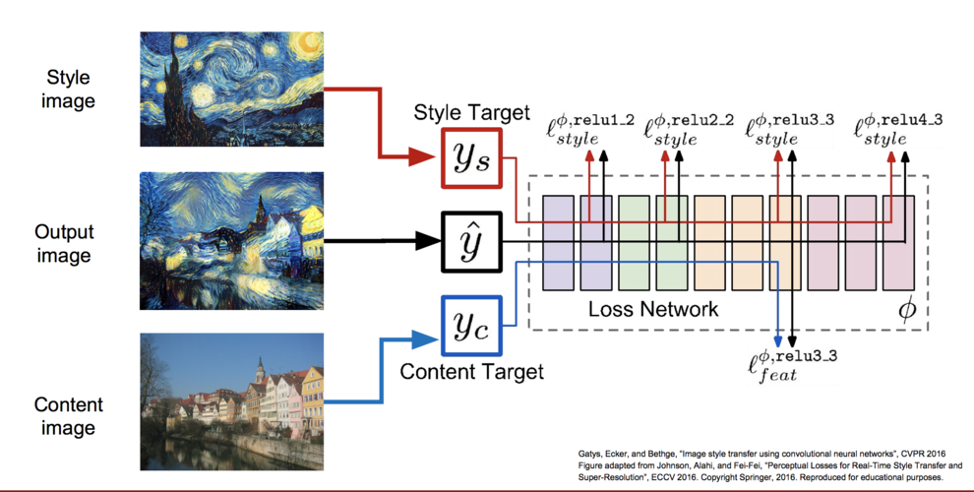
Introduction
Reconstruction
Picture Source:

Slide 8
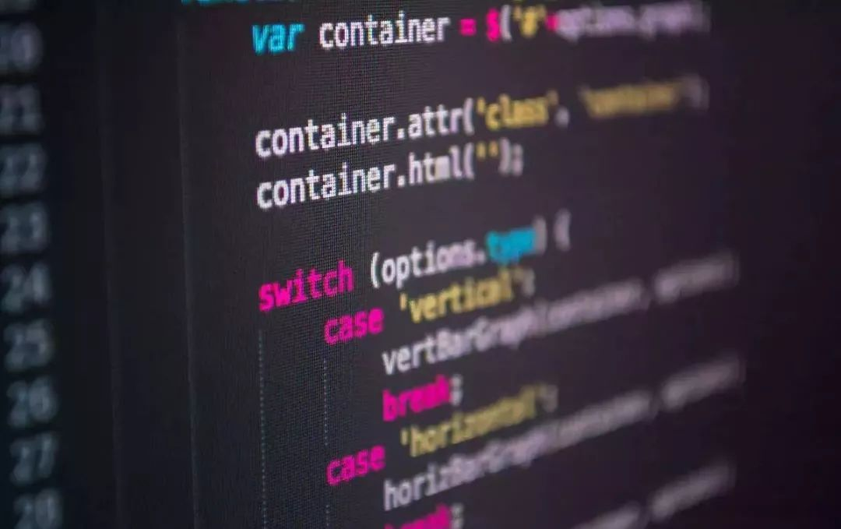
02
Problem analysis
challenge
cause

Slide 9
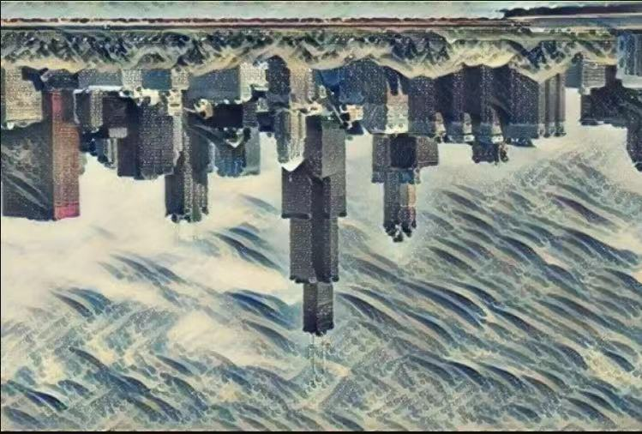
Problem analysis
Three challenge of online image optimization
Reusability
Visual Texture Modeling.
Image Reconstruction.
Speed
The number of model iterations
Algorithm iteration method
Quality
negatively related to speed
Related to training network (VGG16 or VGG19)
Although IOB-NST is able to yield impressive stylized images, there are still some limitations. The most concerned limitation is the efficiency issue. ---- Jing et al. (2020)

Slide 10
Cause
The underlying logic of Machine learning
Since each reconstruction result requires multiple optimization iterations in pixel space, this method is computationally expensive. ---- Jing et al. (2020)
Randomly initialize the noise image
Input VGG loss function
Calculate the gradient of the loss function
Adjust each pixel value
Generated image
Iterative x N
Use different CNN (VGG 19)
Optimized loss function
Optimization iteration equation

Slide 11
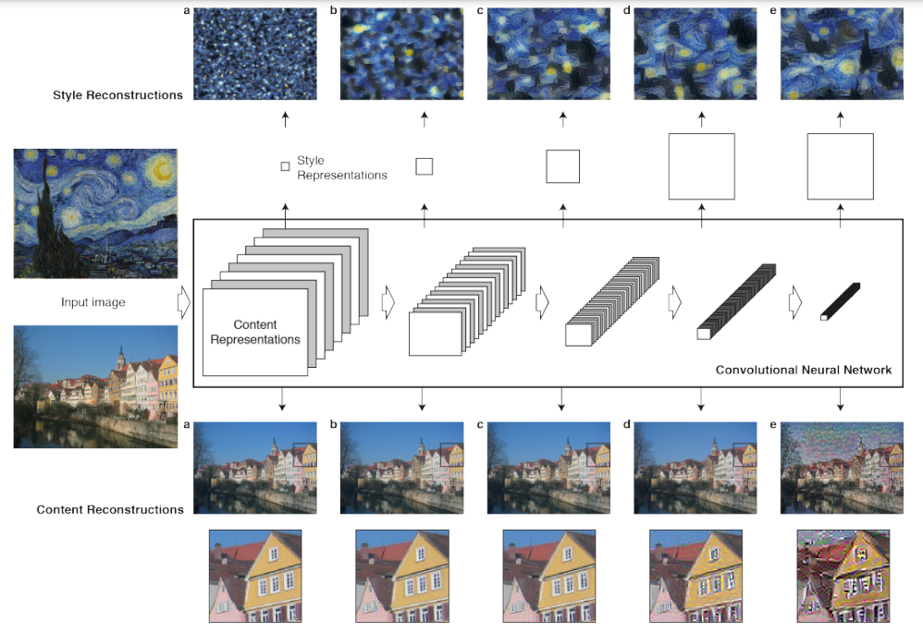
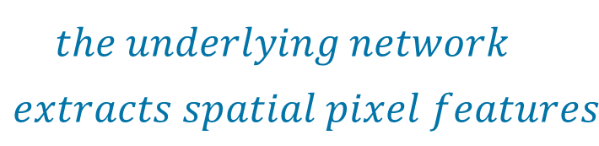
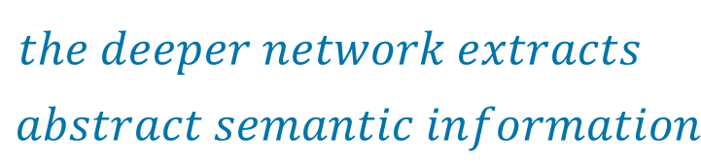
Cause
CNN
$$the underlying network$$
$$extracts spatial pixel features$$
$$the deeper network extracts$$
$$abstract semantic information$$
For style image, the lower layer is color and localised structure, while the deeper layer is texture feature
Picture Source:

Slide 12
03
Methods
The proposed optimization scheme
Notes:
In our project, we mainly research how to transfer texture and color from different images to the content image and improve the quality of the resulting image. Now I will introduce the method we used to implement our problem.

Slide 13
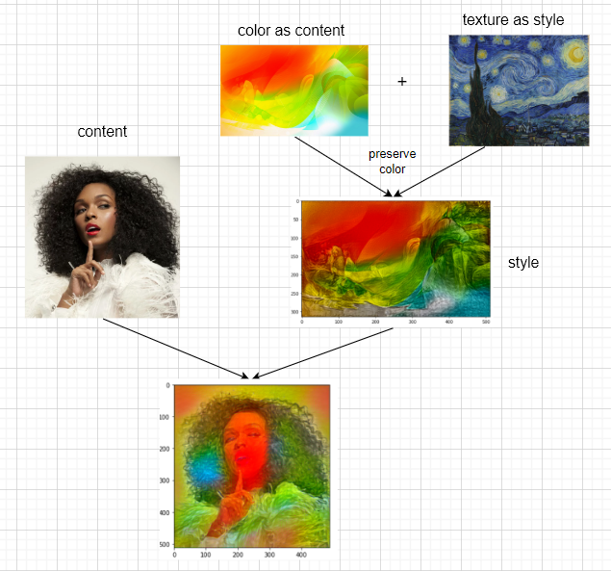
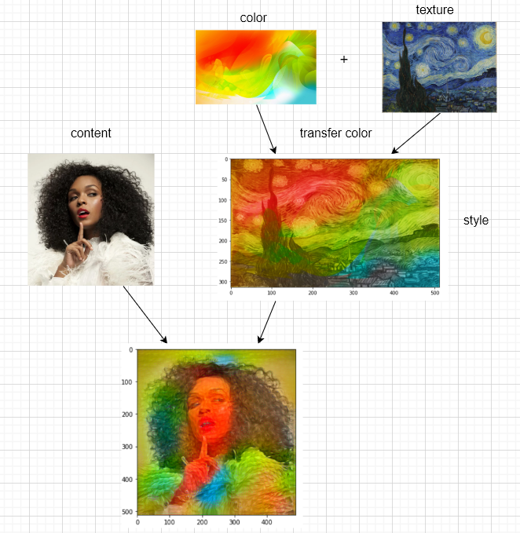
Effect 2 : Concerns about the uncertainty of AI
Methods
Method 1
Method 2
Retail
AI machine
Notes:
We came up with two methods to transfer color and texture from different images to the content image. The first method is doing two times neural style transfer. The first step is to blend color and texture, in this way we can not only get the color from the color image and also get the texture from the style image. Next step is to transfer the new style image to the content, then we get the final result. The second method is first changing the color of style image to the color of color image in style’s luminance channel, which looks like this. Then, do the neural style transfer to get the final result. We will discuss the different results of these two methods in next section.

Slide 14
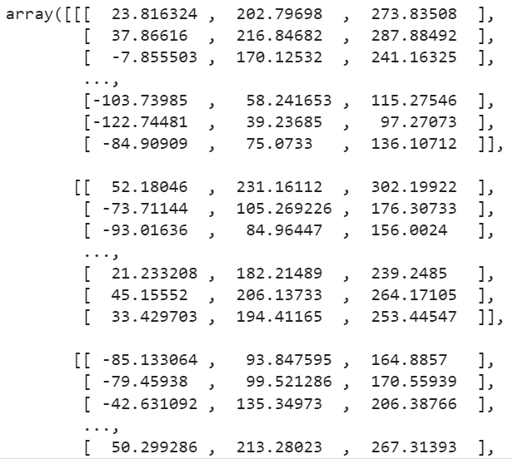
Methods
Transfer color
picture: The result pixel matrix after preserving color style transfer
We implement this function inspired by Gatys, Leon A., et al [4].
They proposed a method that transfer style only in the luminance channel.
But the problem is the transfer of preserving color can only be implemented once. The result cannot be use in another style transfer.
Retail
AI machine
Notes:
We implement the transfer color function inspired by Gatys. They proposed to transfer style only in luminance channel to preserve content color. But the problem is the transfer of preserving color can only be implemented once. The result cannot be used in another style transfer.
The result pixel matrix after preserving color style transfer is shown in the right picture. The type of the data is float32 which cannot be used in the next step migration. The transfer function only accepts tensor matrix with type unit8 and the range should be in [0,255]. therefore, we try to normalize the matrix to the required range.

Slide 15
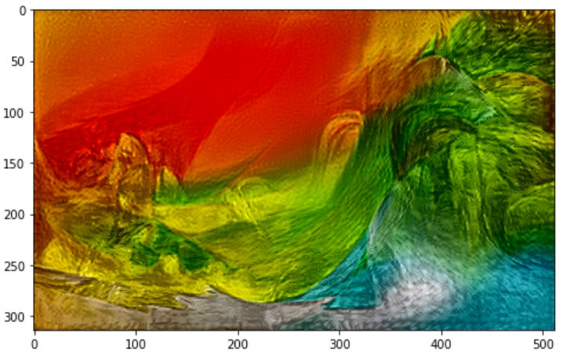
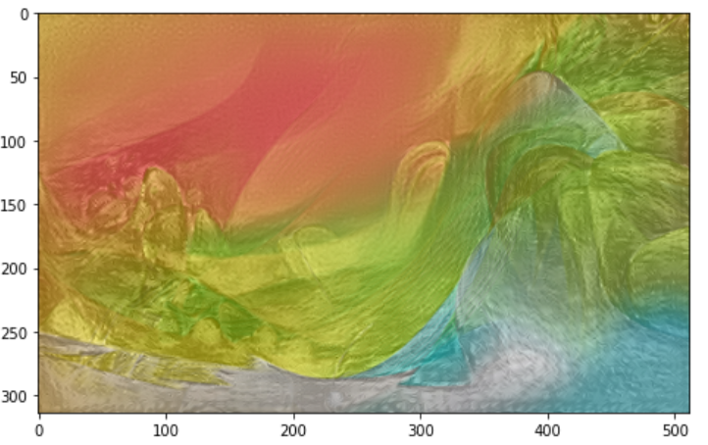
Methods
After Transfer color
The result image
Image after normalization
Notes:
So The left figure shows the original resulting image after the first transfer by using plot show function. The right figure shows the image after we normalization. It is obvious that the brightness of the image on the right is lower than the left one. This is because some colour information is lost when performing BGR interval correction.

Slide 16
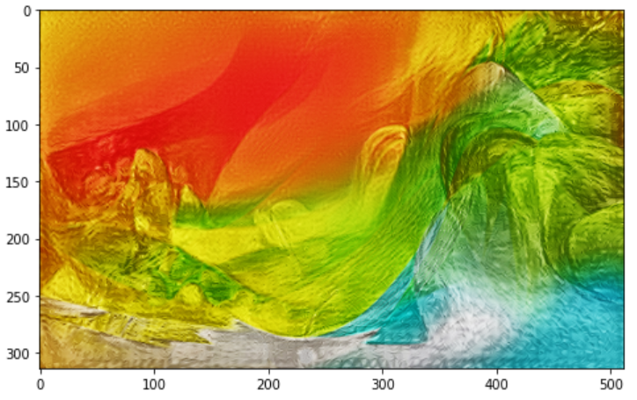
Methods
After Transfer color
Images after normalization
Images after Contrast Stretching
Notes:
Then we decided to do contrast stretching to recover the color feature. The result is as in the right figure. Although there is still some difference between the original figure and processed image. With this problem solved we can perform multiple style transfers.

Slide 17
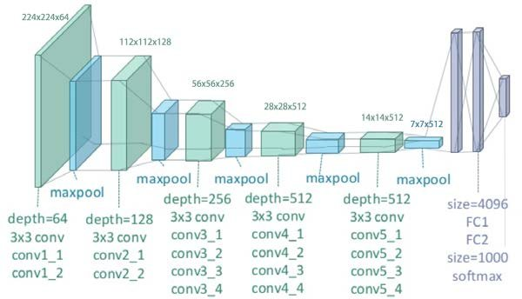
Methods
Different layer as content layer
VGG19
picture source from https://www.researchgate.net/figure/llustration-of-the-network-architecture-of-VGG-19-model-conv-means-convolution-FC-means_fig2_325137356
Notes:
Having finished implementing the fusion of texture, colour and content, the next stage we were focusing on how to improve the quality of the resulting map. As mentioned in the problem analysis, when using different convolutional layers as the content layer there are different results in feature extraction, we would like to further investigate whether the best output layer when performing two style migrations is the same as the best output layer for a single migration. We have used the convolutional layer in the orange box in the figure as a different content feature extraction layer to compare its effect.

Slide 18
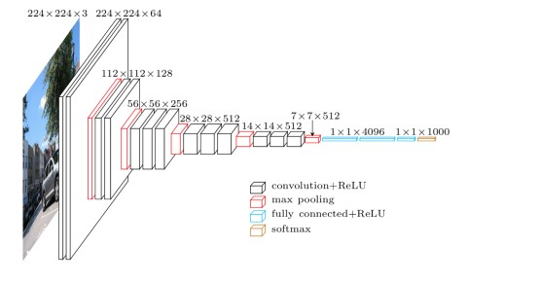
Methods
Different network
VGG16
VGG19
picture source from https://www.researchgate.net/figure/llustration-of-the-network-architecture-of-VGG-19-model-conv-means-convolution-FC-means_fig2_325137356
https://towardsdatascience.com/extract-features-visualize-filters-and-feature-maps-in-vgg16-and-vgg19-cnn-models-d2da6333edd0
Notes:
In addition, we wanted to compare the impact of using different networks on our results. This is because differences in network structure can lead to differences in the effectiveness of the extracted features. We will discuss the difference in the next section. Next, let’s move to Jingyang to discuss our result.

Slide 19
04
Achievement
Optimization results Display

Slide 20
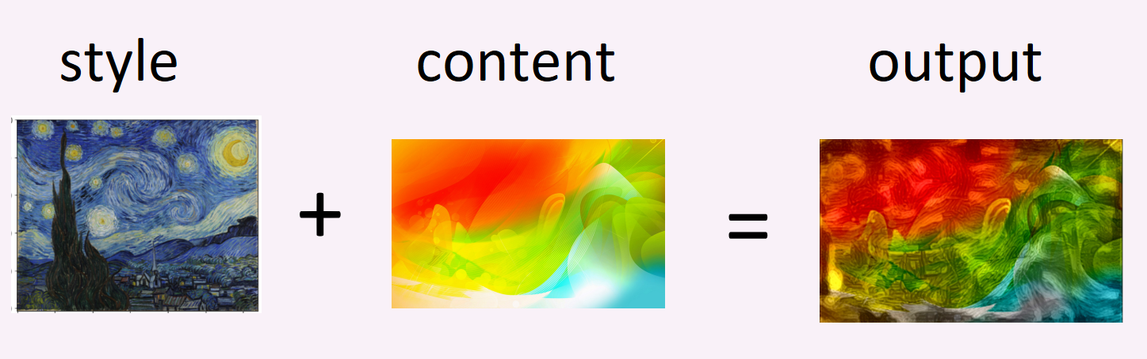
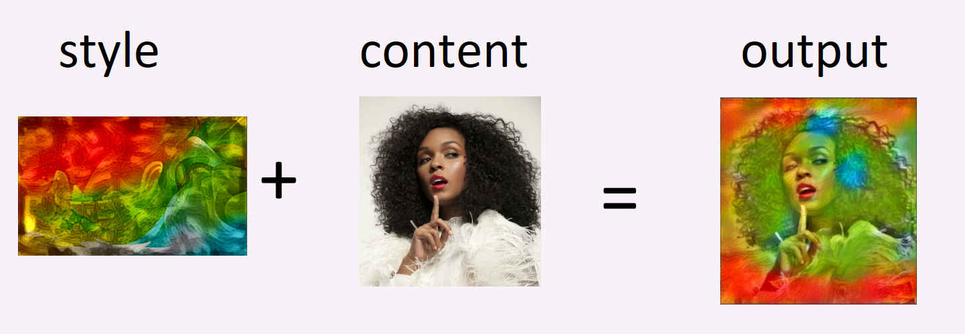
Achievement
Two different methods of color transfer
Method 1
Step 1: color as content +style as style (preserve content color)
Step 2: The output of the previous step is used as the style, and the face is used as the content
picture source from

Slide 21
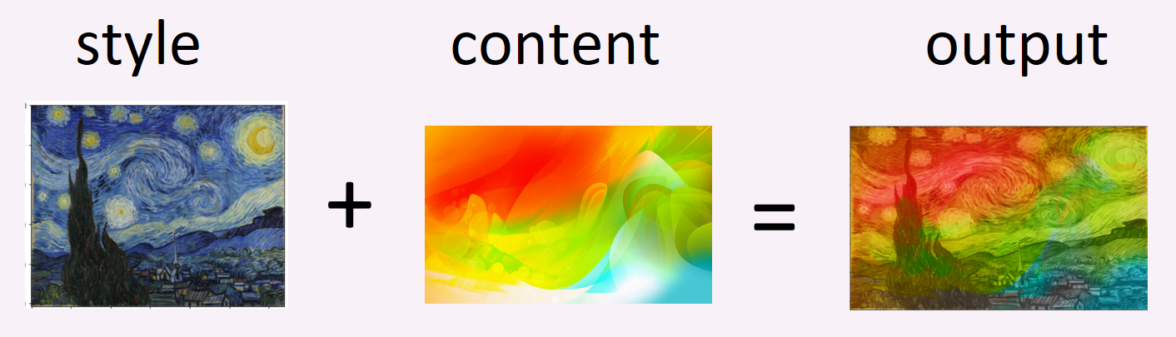
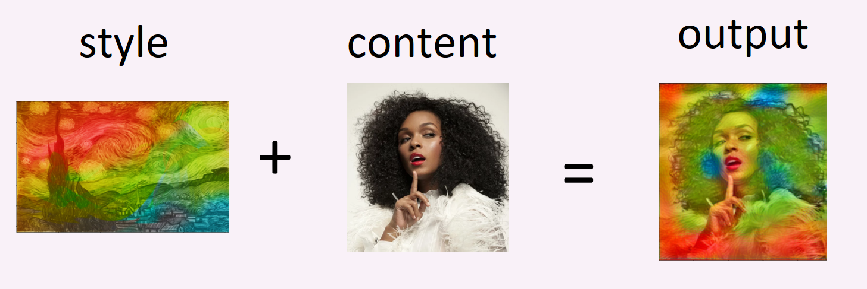
Achievement
Two different methods of color transfer
Method 2
Step 1: overlay the color directly onto the style image
Step 2: The output of the previous step is used as the style, and the face is used as the content
picture source from

Slide 22
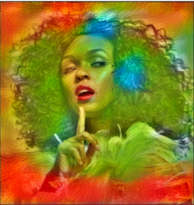
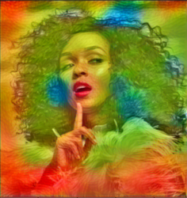
Achievement
Comparison of the results of the two methods
The color distribution of the two methods is similar
The texture effect of the second method is not as obvious as the first method
when we overwriting the color in the second method, it destroys the clarity of the texture of style image
Method 1
Method 2
picture source from

Slide 23
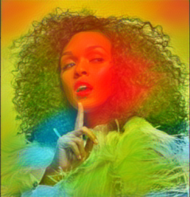
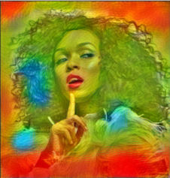
Achievement
Comparison of the results of the two VGG networks
VGG19 obviously learns more painting styles and texture structures than VGG16, so it obtains better style effects.
Reason: Deeper network layers will help extract details and texture information.
VGG 16
VGG 19
picture source from

Slide 24
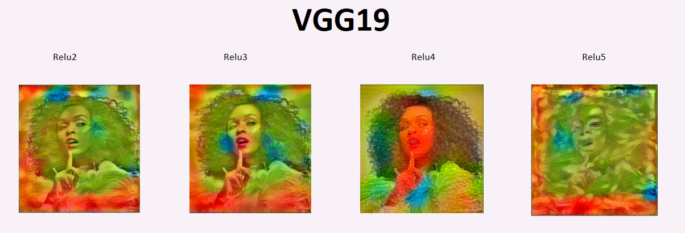
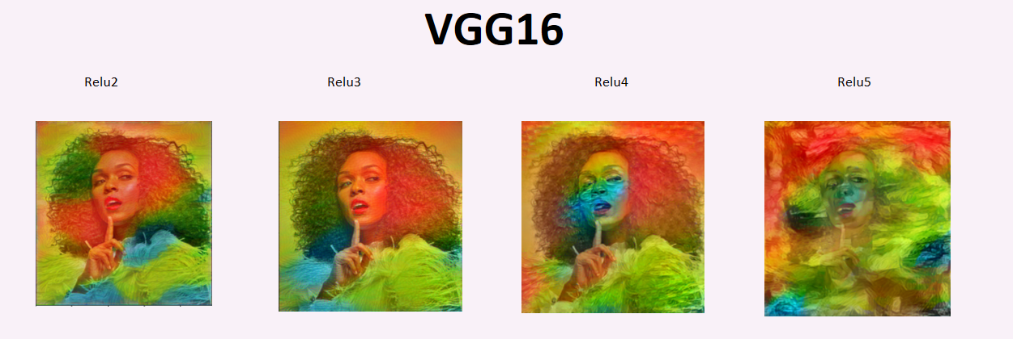
Achievement
Comparison of the results of the two VGG networks
picture source from

Slide 25
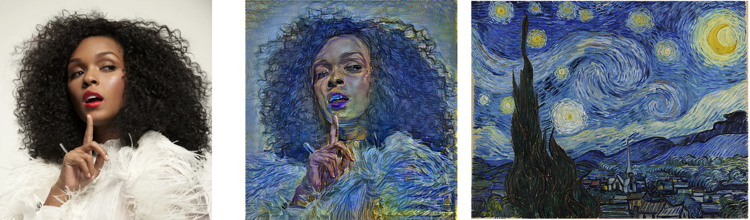
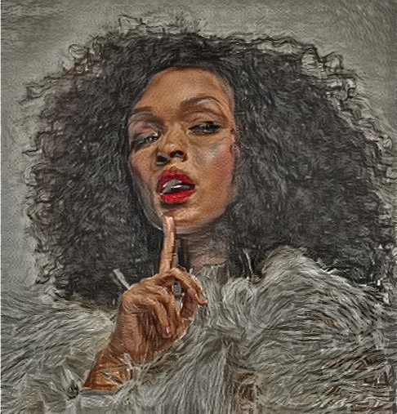
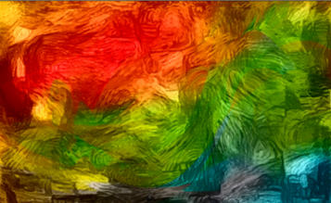
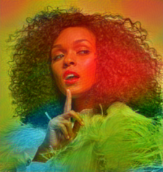
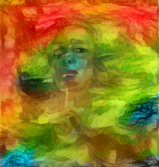
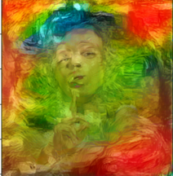
Achievement
Analysis: In fact, we can see that the style transfer did not really transfer Van Gogh's unique swirling style, but only the more general oil painting style.
Conclusion: Deeper feature layers can extract style and texture, but this may only be paint tool style, not artist style.
picture source from

Slide 26
Achievement
我们的工作主要是在通常的画风迁移的基础上，新增加了有趣的色彩迁移部分。我们希望能以此能让AI更好的具有拟人的艺术创作能力。
但实际上当前的画风迁移技术大多仅仅停留在对图像的纹理/棱角锐度层面的迁移，这并不足以复制真正的大师作品。对于色彩迁移来说，上色的逻辑也仅仅是为了最小化信息损失，而不是产生美感。
尽管当前的工作可能已经拥有创造一些看上去不错的画作，但距离人工智能学会人类艺术创作的真谛还有很长的路要走。

Slide 27
05
Conclusion
Vision of Neural Style Transfer

Slide 28
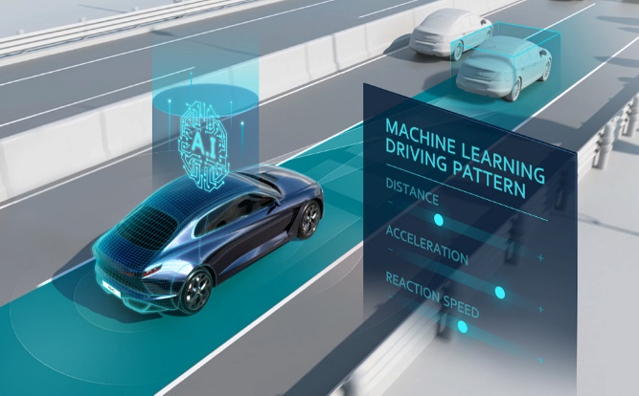


Conclusion
The application of NST
Application of AI in different fields
AI technologies including machine learning, natural language processing, computer vision and intelligent adaptive technology have made great strides over the last decade.
Automobile industry
Medical Field
Retail Industry
Aided driving
Automatic driving
Medical image
Health management
Disease risk prediction
Face recognition
Smart supply Chain
Self-clearing payment
“From autonomous cars and adaptive email-filters to predictive policing systems, machine learning (ML) system outperform humans on specific tasks.” ---- Doshi-Velez & Kim (2017)
picture source from Baidu Gallery

Slide 29

Conclusion
Redefine AI by three principles
Realize human value
intelligently pursue objectives
Interpretable Machine learning
Reduce machine uncertainty
ensure the instruction correct
Vision of NST
Create reliable AI to better serve human beings
AI will appear in more fields to assist human beings

Slide 30
Reference List
L. A. Gatys, A. S. Ecker, and M. Bethge, “Image style transfer using convolutional neural networks,” in Proceedings of the IEEE Conference on Computer Vision and Pattern Recognition, 2016, pp. 2414–2423.
Jing, Y, Yang, Y, Feng, Z, Ye, J, Yu, Y & Song, M 2020, ‘Neural Style Transfer: A Review’, IEEE transactions on visualization and computer graphics, vol. 26, no. 11, pp. 3365–3385.
L. A. Gatys, A. S. Ecker, and M. Bethge 2015, ‘A Neural Algorithm of Artistic Style’, arXiv.org.
L. A. Gatys, M. Bethge, Hertzmann A, et al. Preserving color in neural artistic style transfer[J]. arXiv preprint arXiv:1606.05897, 2016.

Slide 31
Thanks for listening
Neural Networks

Slide 32

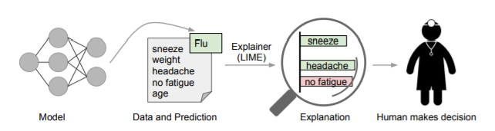
Strategies 2
Interpretable Machine learning
Interpretable definition: the ability to explain or to present in understandable terms to a human in the ML systems.
--- Doshi-Velez & Kim (2017)
The process of explaining individual predictions
Predictive factors
Predictive evidence
Figure 2: explaining individual predictions
picture source: Ribeiro et al. (2016)
Benefits: one of the ways to ensure that the machine decision is within human comfort level.
Scientific Understanding
Safety
Ethics
some illustrative scenarios can be addressed:

